Slide 1
IA from outer space
a case-study
Notes:
Nathalie

Slide 2
Notes:
Nathalie: Martin is a requirements engineer and ux designer in the financial industry.
Martin: Nathalie is a software engineer for web applications and agile coach.
We both study together Human Computer Interaction Design at the University of Applied Sciences in Rapperswil and got in touch with the IA element for the first time in our studies.

Slide 3
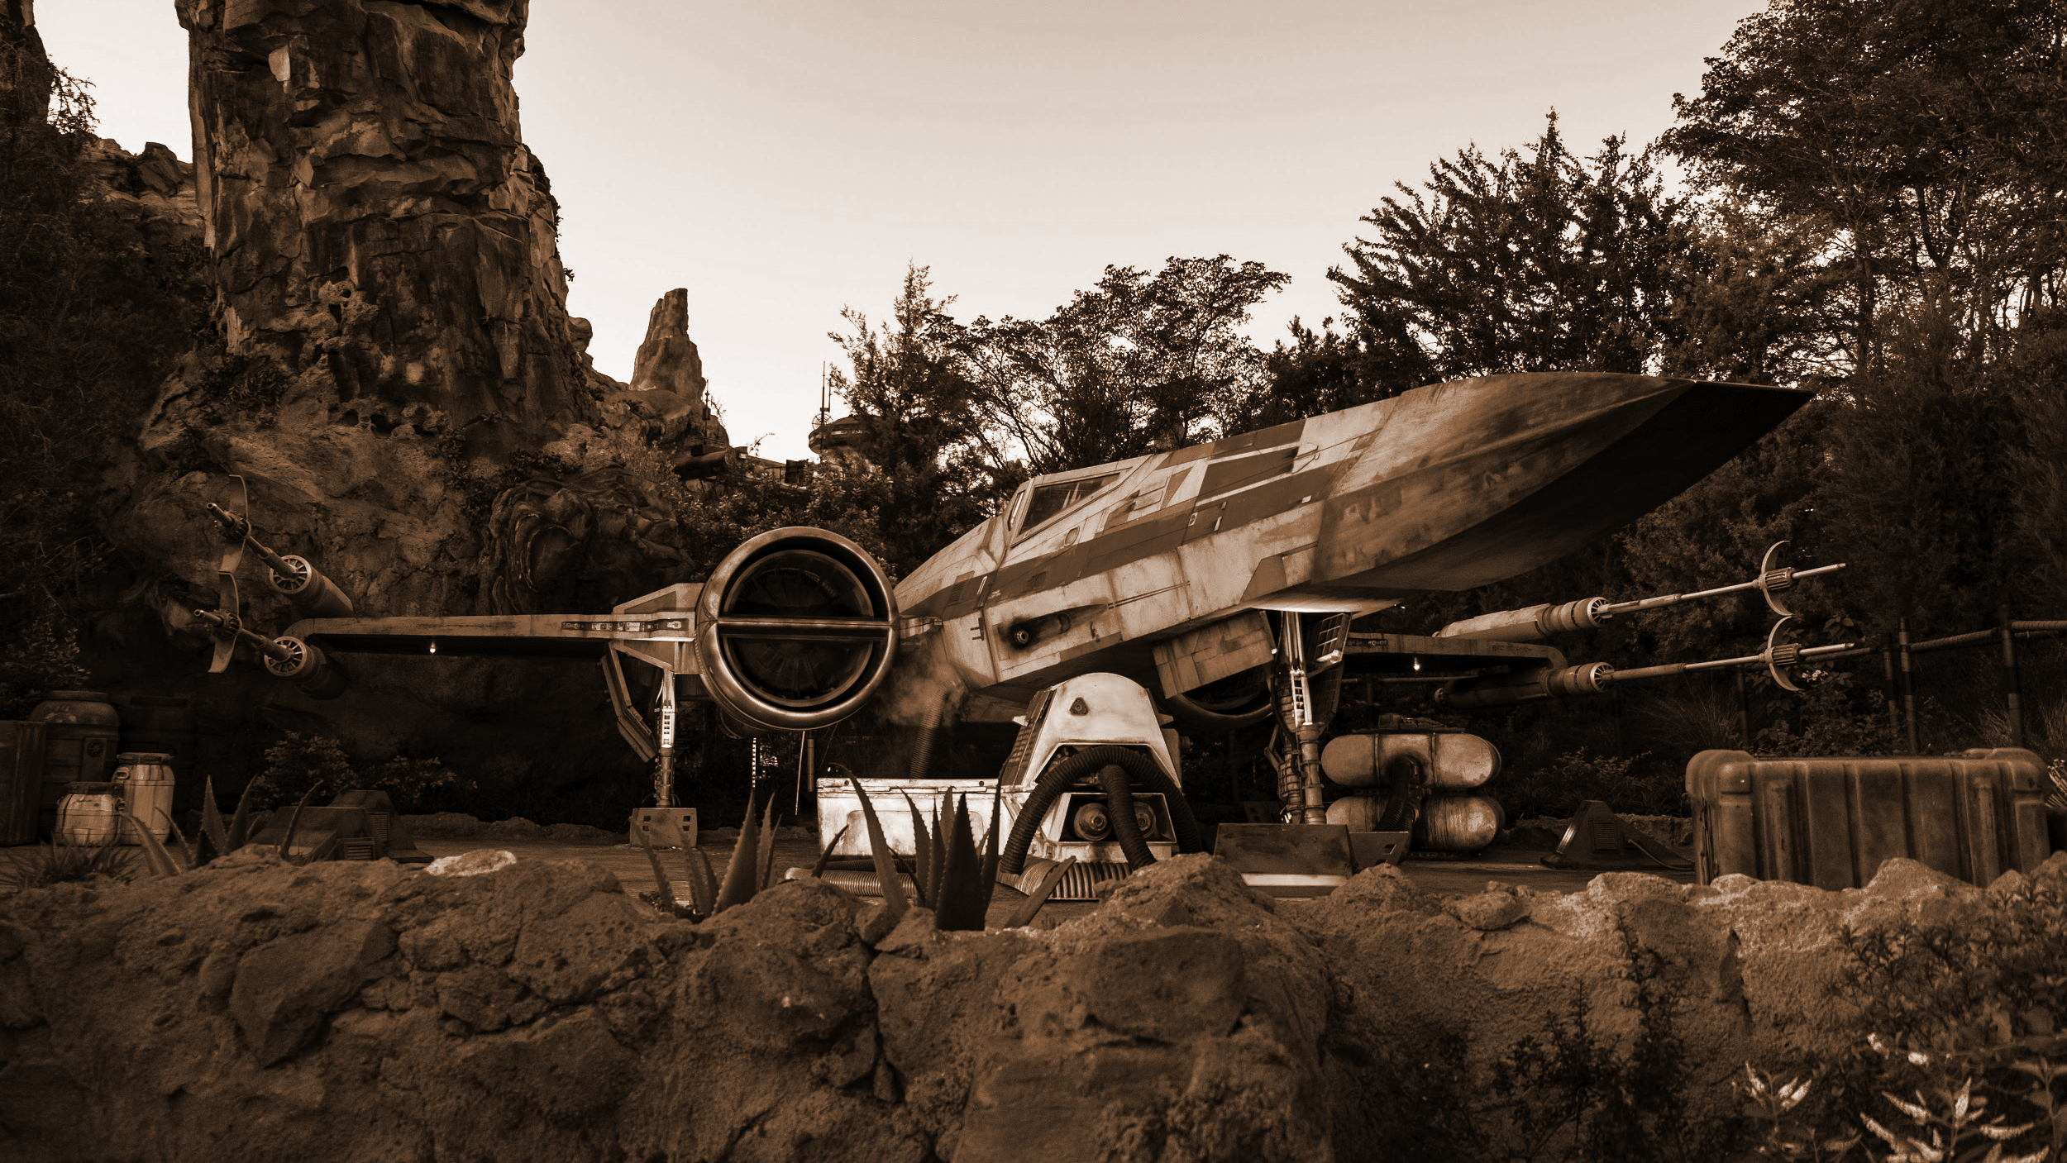
Starting point
Railway company
with 1’500 employees and 12’000’000 guests a year
Offers a big variety of products & services
for individuals and companies
Their website contains a huge amount of information
for different target groups
growing content, sometimes not compliant with rules & guidelines
Notes:
Martin: Today, we are telling you some insights of our case-study, which we have written in our studies in Information Architecture. We analyzed the website of a railway company and wanna share our approach, results and learnings with you.

Slide 4
Reading the book
Designing Connected Content
by Mike Atherton & Carrie Hane
Notes:
Martin: First of all, we have read the book Designing Connected Content from Mike & Carrie. The book shows the IA-process from building information structures until entering data into your Content Management System. We recommend this book for a brief introduction in Information Architecture in general and for Content & Domain Modeling in specific.

Slide 5
Approach
Content inventory
Use cases & scenarios
Ask the experts
Domain & Content model
Bring the experts back
Notes:
Martin: Content inventory: Urls well formed, hierarchy matches navigation
Use cases & scenarios: Based on user research, helps for a good preparation for the expert interview and focus for domain model
Expert interview: Helps understanding the domain
Domain model: Visualize the domain objects and their relations
Expert review: Validate domain model & underlying assumptions with the experts
Content model: Derive from domain model with focus on presentation for the user

Slide 6
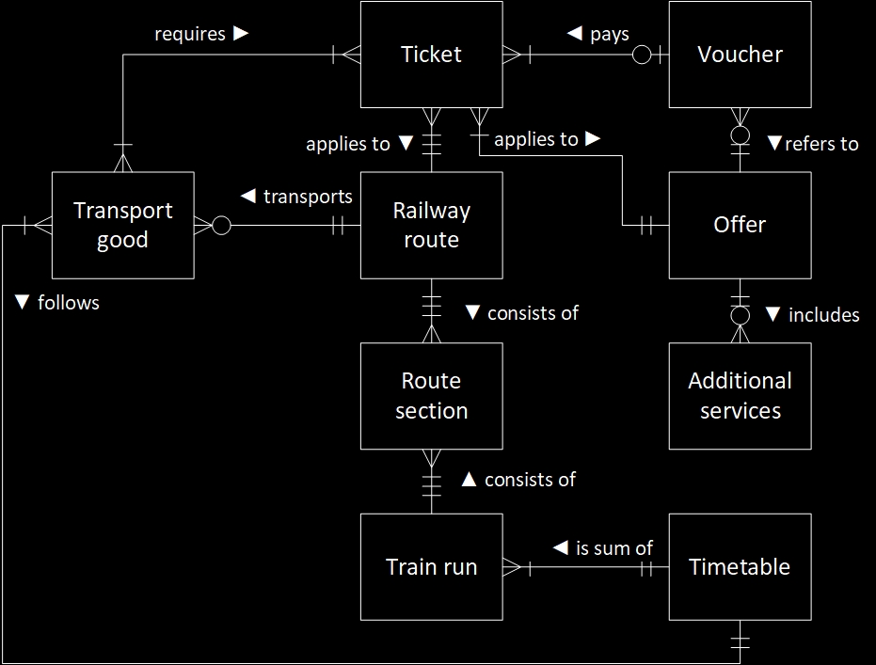
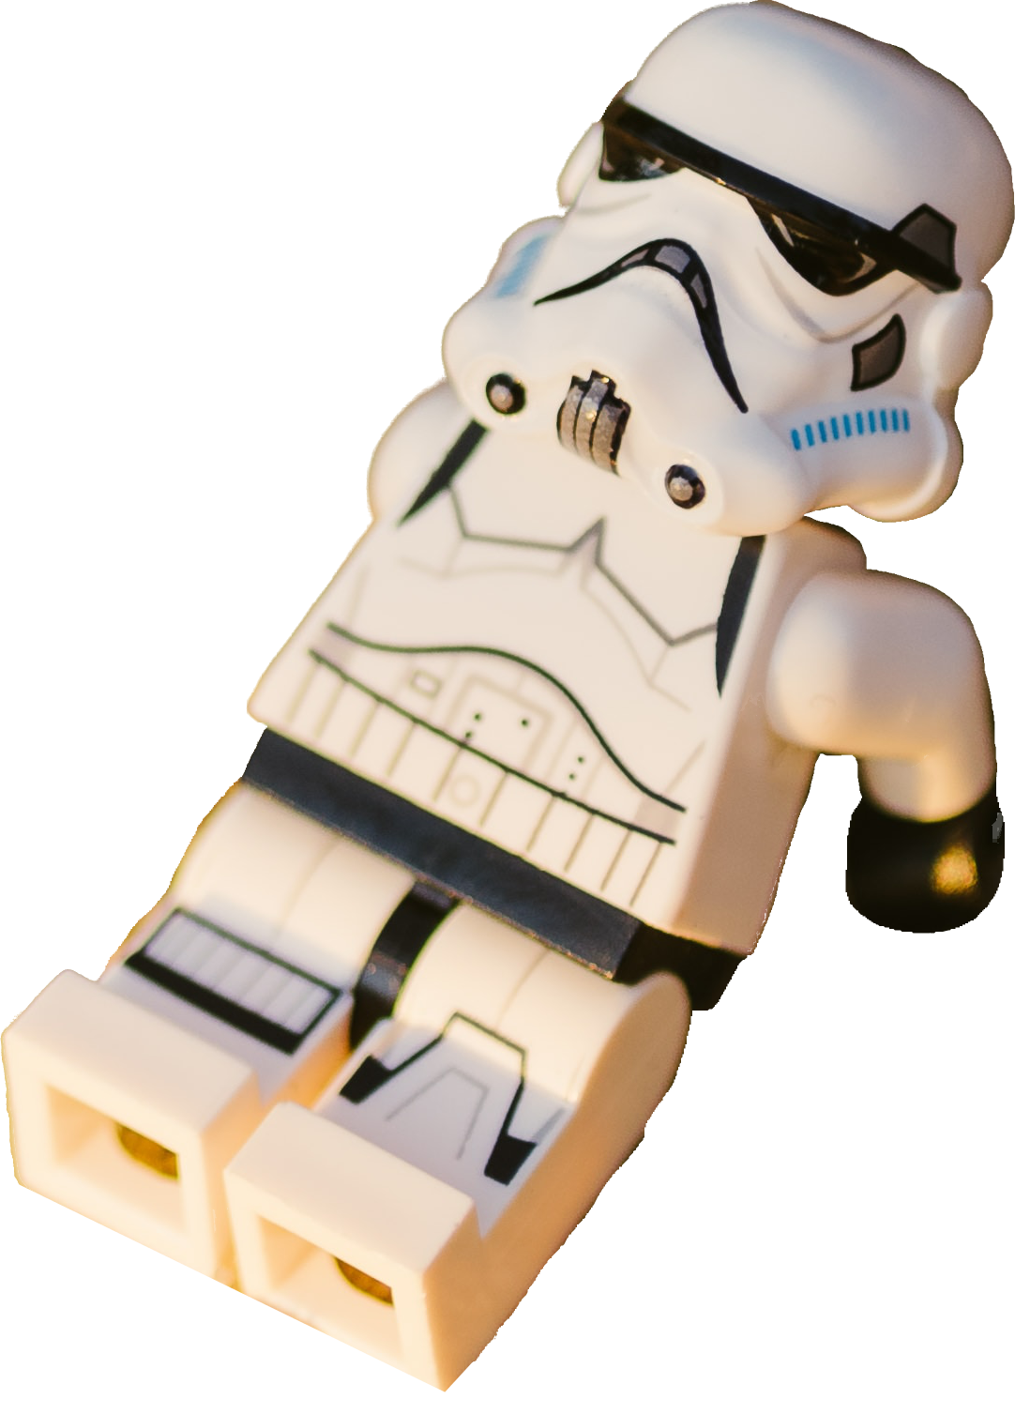
Domain Model
Notes:
Nathalie: Important factors:
Domain objects and technical terms for them
Relations between domain objects
Craw’s foot-Notation for cardinalities
Goal: Understand the domain and visualize this know-how about the domain

Slide 7
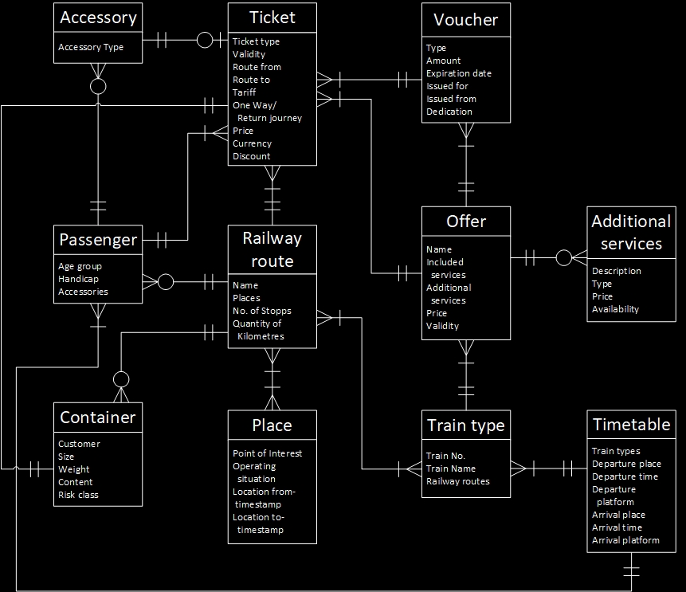
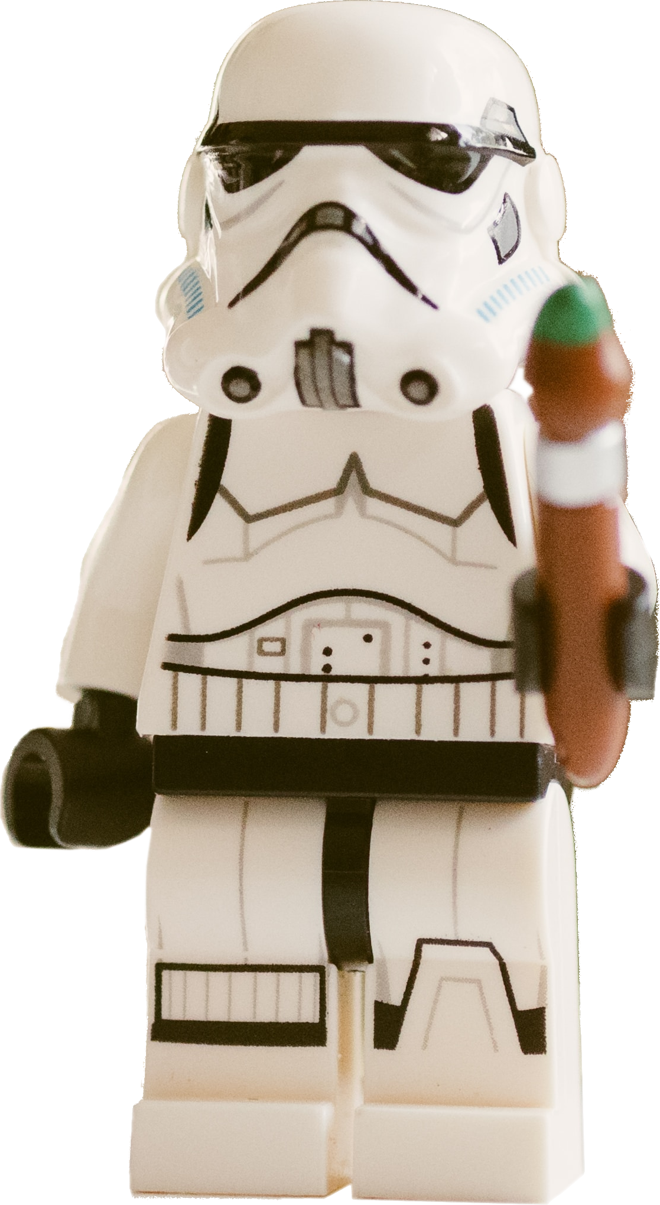
Content Model
Notes:
Nathalie: Important factors:
Content objects always with attributes
Relations between content objects
Cardinalities and relations can change from the Domain Model to the Content Model.
Example: Offer-Voucher-Relation: Link from Offer to Voucher and back.
Goal: Visualize the content and how it is linked to each other

Slide 8
Differences between Domain & Content Model
Transport
good
Passenger
Accessory
Container
Notes:
Nathalie: We have seen, that the domain object “Transport good”, which is quite generic has to be split into the content objects named Passenger, Accessory and Container.

Slide 9
Learnings
Ask the users
For developers: Domain model is comparable to DB or class model
Iterate the domain model with experts
Iterate between screen sketches and content model
Model once, redesign all the time
Notes:
Punkte 1, 3 und 5 für Martin
Punkte 2 + 4 für Nathalie
Good Information Architecture should be based on User Research
For me as a developer it helped me, that Domain Modeling is similar to DB or class Modeling.
The domain model should be iterated and refined together with experts
It helped us to sketch some screens, refine content model based on sketches and so on…
Because we model future use cases, the content model could remain stable over several user interface redesigns

Slide 10
Thank you

